Slide 1
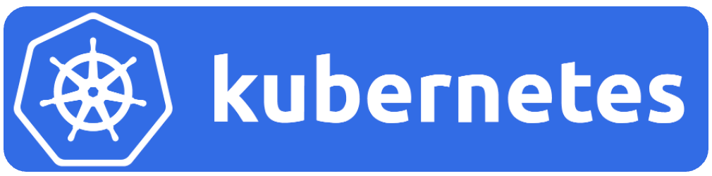
Orchestration of containers
Presented by: Dave Weilert

Slide 2
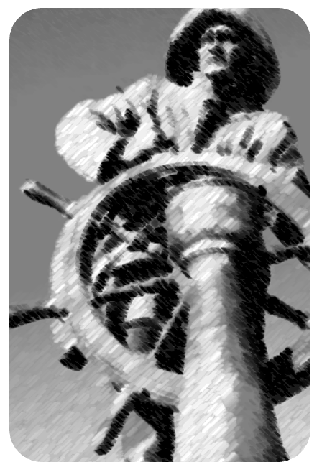
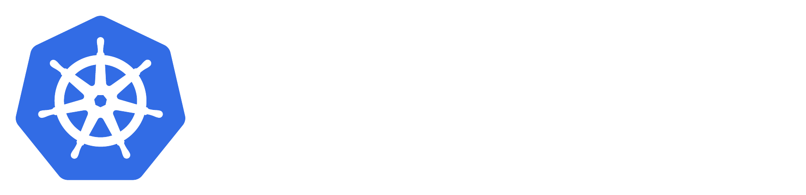


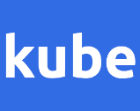
Kubernetes (Greek for “steersman”)
also known as
8
or

Slide 3
Why k8s?
k
u
b
e
r
8
n
e
t
e
s

Slide 4
Are containers used anywhere?
Estimates of Google’s usage of containers:
Starting with the 4 billion containers per week figure from a 2014 report and compounding it at 20% annual growth would lead to a 2023 estimate of
~24 billion containers per week
(or)
~3.4 billion containers per day
Conservative global estimates are in the range of 20 billion containers per day.

Slide 5
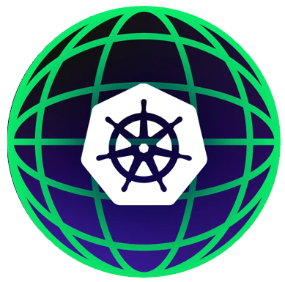
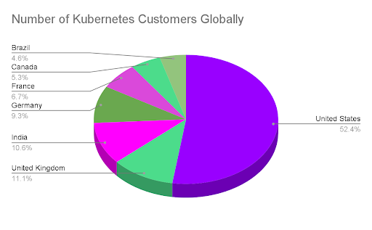
Kubernetes global adoption
Over 50,000 businesses worldwide have made Kubernetes their preferred cluster management solution, demonstrating the platform's extraordinary global acceptance. This widespread worldwide presence highlights Kubernetes' adaptability and efficiency in addressing the demands of enterprises in various sectors and industries.
Source: https://edgedelta.com/company/blog/kubernetes-adoption-statistics

Slide 6
How to manage thousands of containers
Kubernetes can be summarized as a platform that enables efficient, scalable, and resilient container application management by automating how containers are deployed, managed, and maintained.

Slide 7
Kubernetes
Kubernetes is:
Platform \ “an Orchestration Layer”
Extensible & Resilient
Declarative
Open Source
Kubernetes is not:
Simple

Slide 8
Kubernetes helps solve these issues
Load balancing
Horizontal Scaling
Self Healing
Automated Rollouts and Rollbacks
Secret and Configuration Management
Storage Orchestration

Slide 9


Kubernetes origin
Google created and open-sourced the software.
Generation | Name
1st | First generation container-management system was called Borg.
2nd | Second generation container-management system was called Omega.
3rd | Third generation container-management system was called Kubernetes.
Kubernetes is now a CNCF project.

Slide 10

Kubernetes – 10 years old
Kubernetes celebrated it’s 10-year mark since it’s first release in July 2015.
Over the last decade, Kubernetes has evolved rapidly, becoming the de facto standard for container orchestration in the cloud-native ecosystem, supported by major cloud providers and widely adopted across industries.

Slide 11
Kubernetes?
Aspect | Explanation
What Kubernetes Does | - Automates deployment and management of applications across cloud and on-premises environments. - Ensures applications stay available and can recover from failures automatically.
Why Kubernetes Matters | - Improves operational efficiency by automating scaling and updates without downtime. - Provides flexibility by running applications across multiple cloud providers and data centers. - Accelerates development cycles with a standardized platform for testing and releasing applications.
Key Business Benefits | - Cost Efficiency: Optimizes infrastructure usage, reducing operating costs. - Agility: Enables faster deployment and scaling, helping businesses adapt to market and user needs. - Resilience: Provides high availability and reliability, protecting business continuity and enhancing customer satisfaction.

Slide 12
Component overview
Kubernetes high-level components

Slide 13
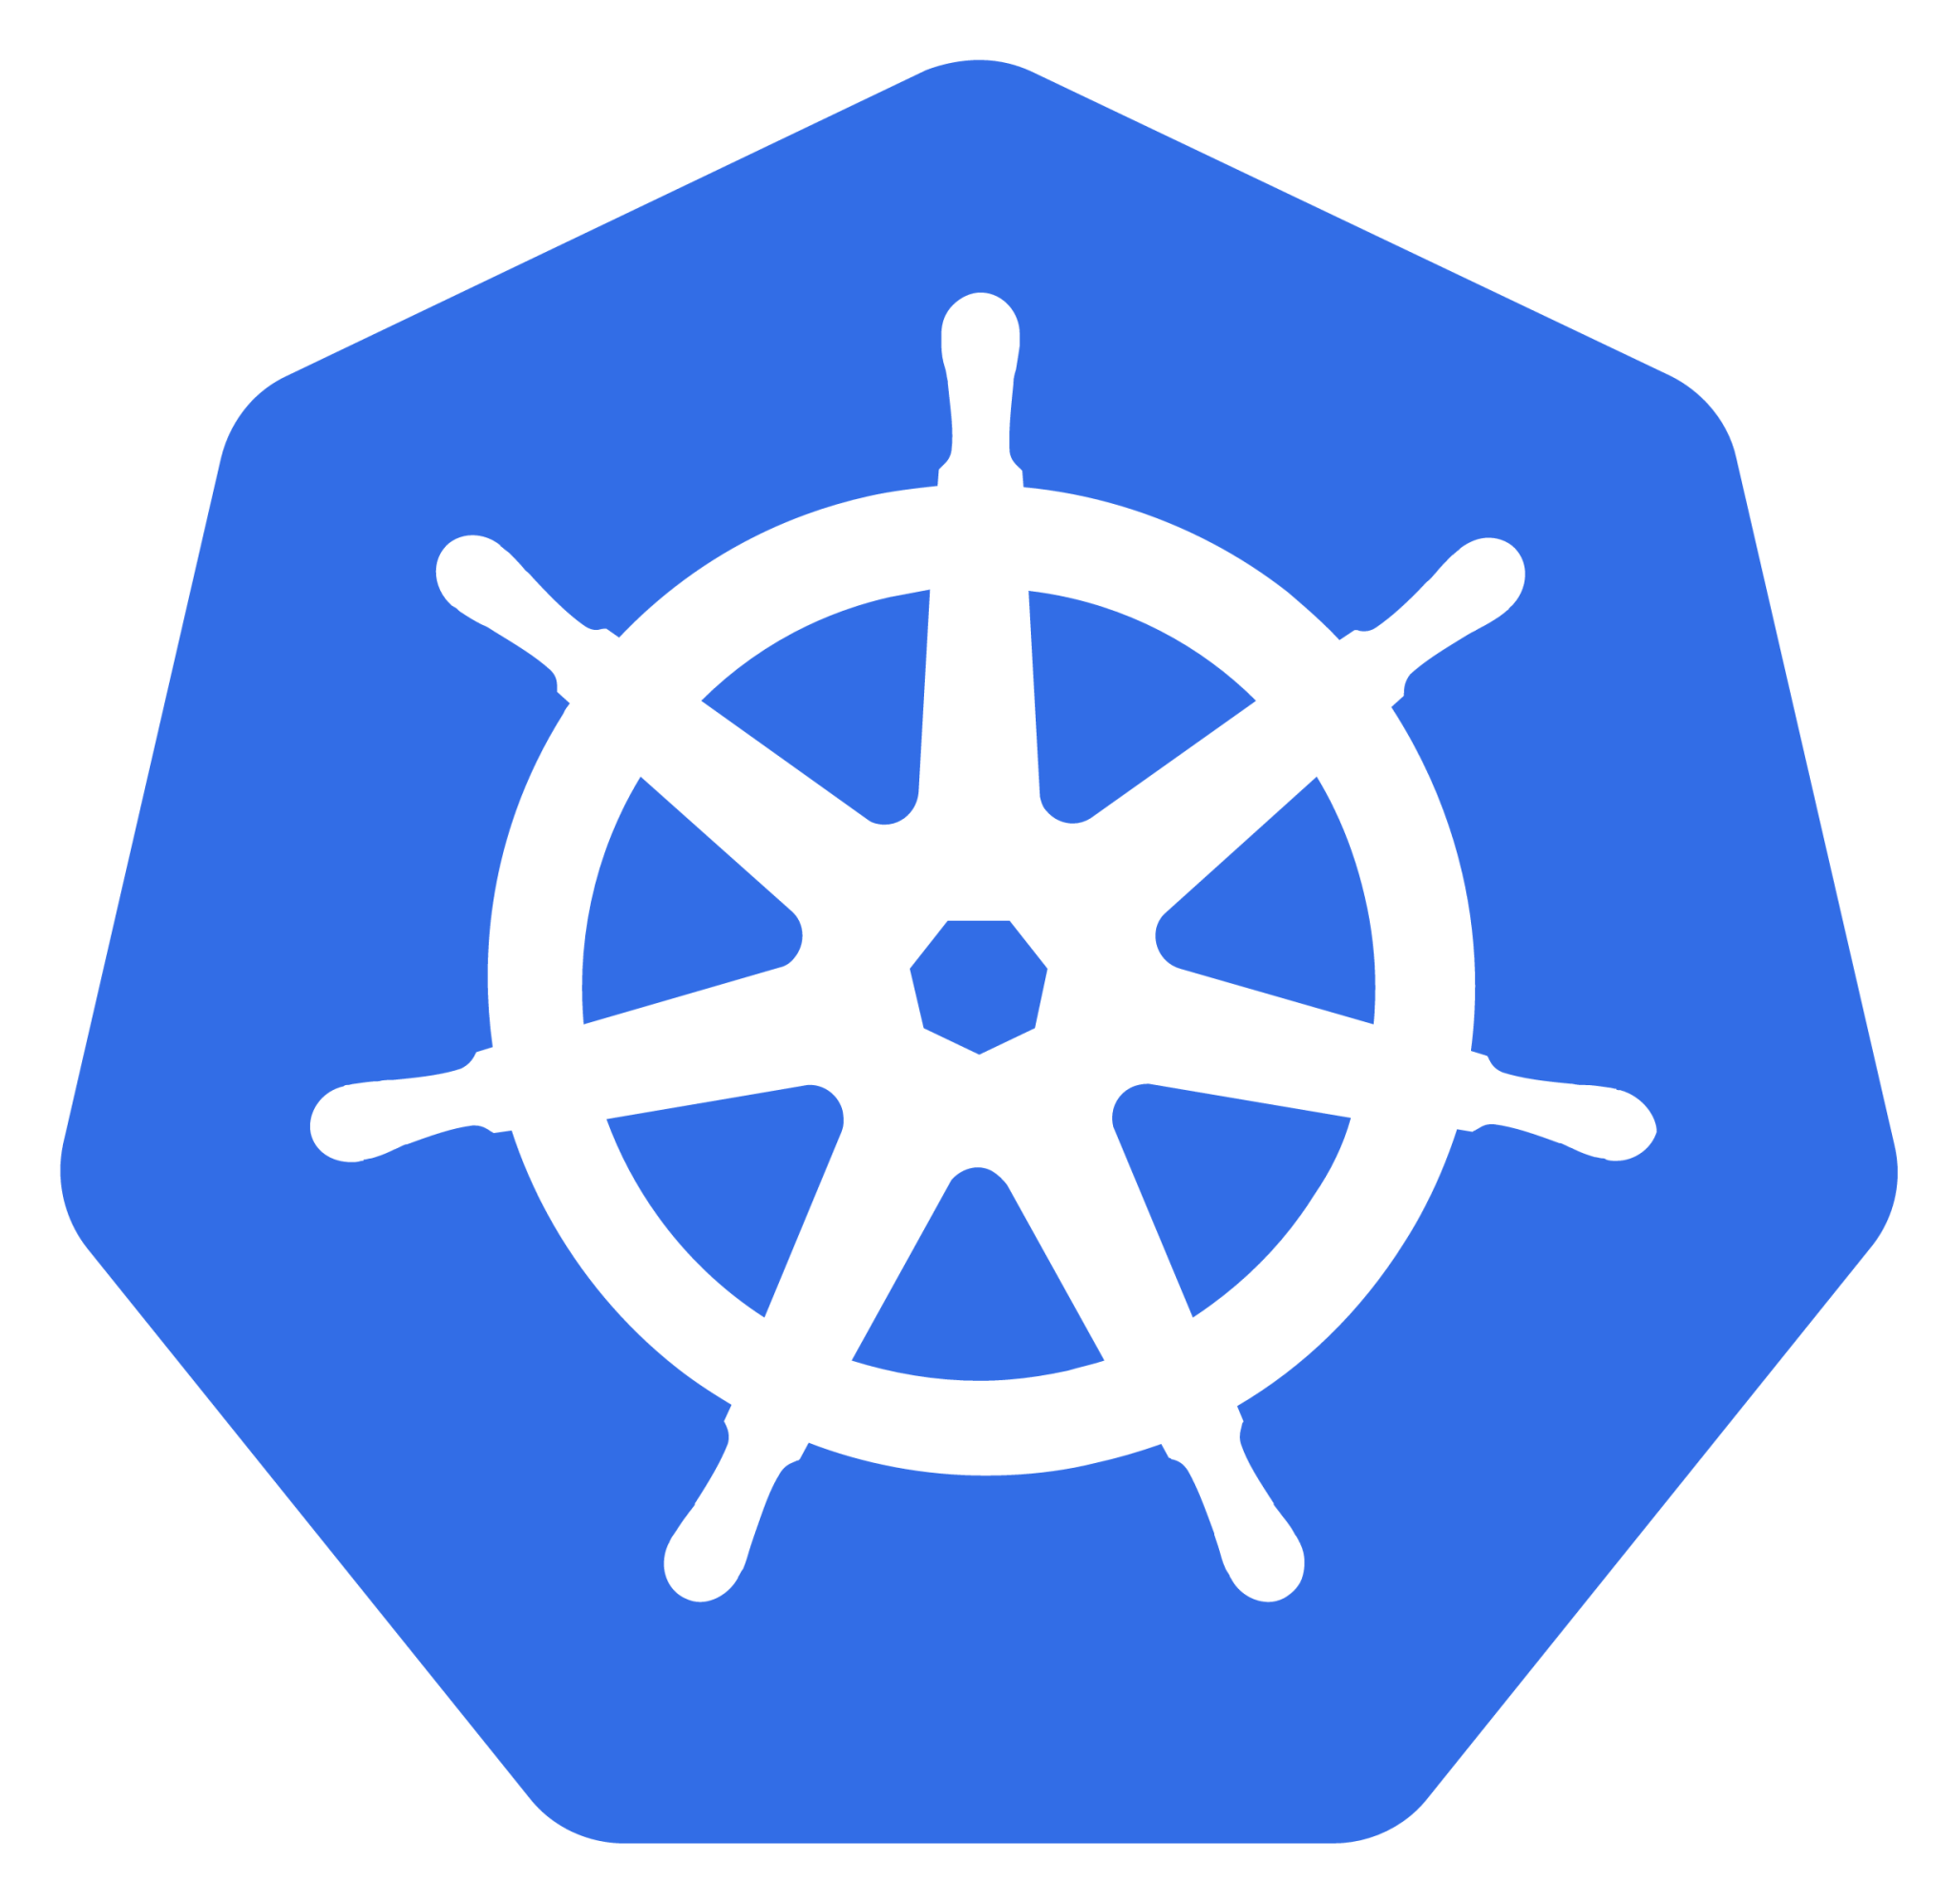
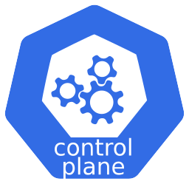
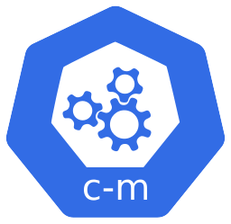
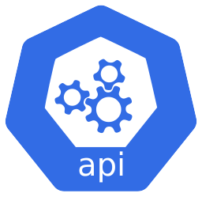
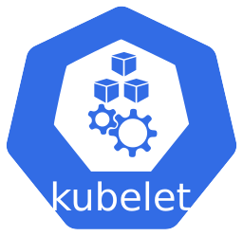
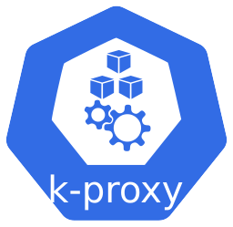
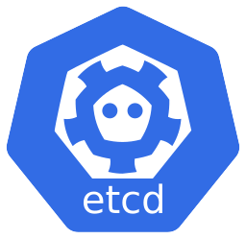

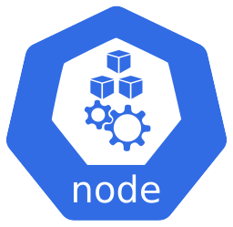
Kubernetes Components
Overview of components
Cluster
Control Plane
Container Runtime
Container Runtime
Container Runtime
Worker Node
Worker Node
Worker Node
Master Node

Slide 14
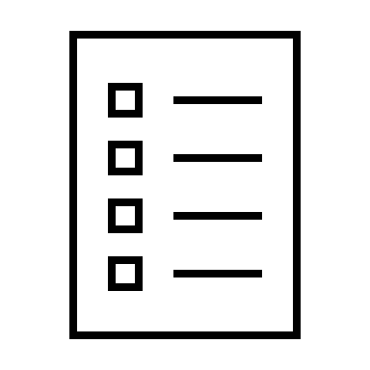



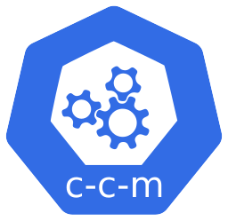
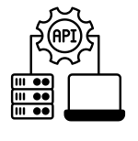
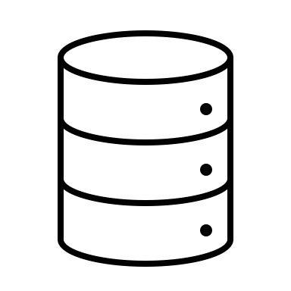
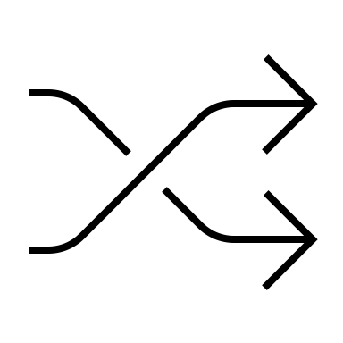
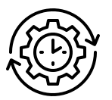
Kubernetes Components
Control Plane components
Control Plane
Controller Manager
Runs controllers to implement Kubernetes API behavior.
Cloud Controller Manager
(optional)
Integrates with underlying cloud provider(s).
API Server
The core component server that exposes the Kubernetes HTTP API
etcd
Consistent and highly-available key value store for all API server data
Scheduler
Looks for Pods not yet bound to a node and assigns each Pod to a suitable node.

Slide 15
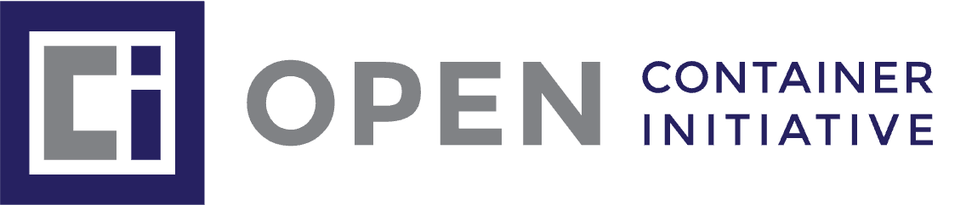
Kubernetes Components
Node components
Kubelet
Ensures that Pods are running, including their containers.
Kube-Proxy (optional)
Maintains network rules on nodes to implement Services.
Container Runtime
Container Runtime
OCI compliant software that is responsible for running containers.
Worker Node

Slide 16
Kubernetes Nodes
Kubernetes has two Node types, Master and Worker.
Master Node(s)
Worker Node(s)
Master nodes, also known as control plane nodes, manage and orchestrate the Kubernetes cluster.
Worker nodes are the machines where the actual applications (pods) are deployed and run. Each worker node is responsible for hosting the pods assigned to it by the master node
Control Plane
Container Runtime
Worker Node
Master Node

Slide 17
Kubernetes Nodes
Kubernetes supports multiple Master and Worker nodes.
Master Node(s)
Worker Node(s)
High Availability
One to thousands
Control Plane
Container Runtime
Container Runtime
Container Runtime
Container Runtime
Container Runtime
Container Runtime
Control Plane
Worker Node
Container Runtime
Worker Node
Worker Node
Worker Node
Container Runtime
Container Runtime
Container Runtime
Worker Node
Worker Node
Worker Node
Container Runtime
Container Runtime
Container Runtime
Worker Node
Worker Node
Worker Node
Container Runtime
Container Runtime
Container Runtime
Worker Node
Worker Node
Worker Node
Container Runtime
Container Runtime
Container Runtime
Worker Node
Worker Node
Control Plane
Worker Node
Container Runtime
Container Runtime
Container Runtime
Worker Node
Worker Node
Worker Node
Container Runtime
Container Runtime
Worker Node
Worker Node
Worker Node
Container Runtime
Container Runtime
Worker Node
Worker Node
Container Runtime
Container Runtime
Worker Node
Master Node
Worker Node
Container Runtime
Container Runtime
Worker Node
Container Runtime
Worker Node
Container Runtime
Container Runtime
Worker Node
Container Runtime
Worker Node
Container Runtime
Worker Node
Container Runtime
Worker Node
Container Runtime
Worker Node
Container Runtime
Worker Node
Container Runtime
Worker Node
Master Node
Container Runtime
Worker Node
Container Runtime
Worker Node
Container Runtime
Worker Node
Container Runtime
Worker Node
Container Runtime
Worker Node
Container Runtime
Worker Node
Container Runtime
Worker Node
Container Runtime
Worker Node
Container Runtime
Worker Node
Container Runtime
Worker Node
Container Runtime
Worker Node
Container Runtime
Worker Node
Container Runtime
Worker Node
Container Runtime
Master Node
Worker Node
Worker Node
Worker Node
Worker Node
Worker Node

Slide 18
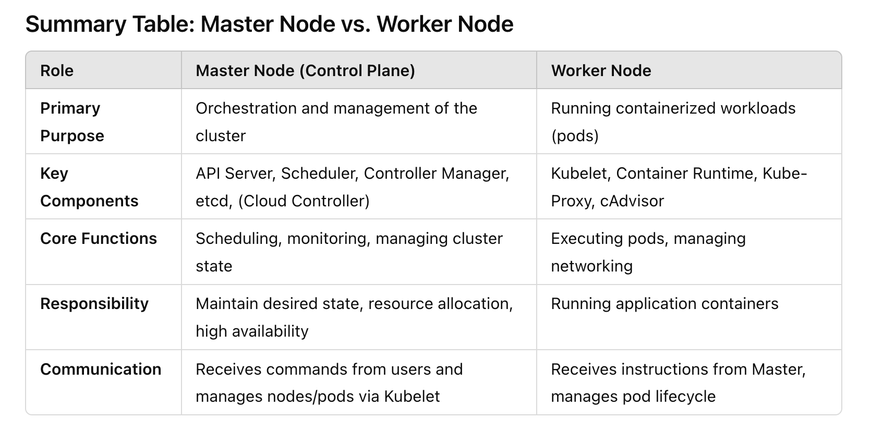
Kubernetes Nodes
Comparison of the node types.

Slide 19
C “X” I interfaces
CNI, CRI, CSI

Slide 20
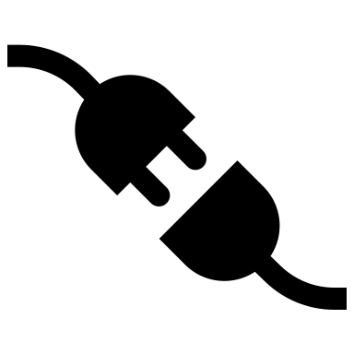
Kubernetes C “x” I interfaces
CNI : Network, CRI : Runtime, CSI : Storage
Cluster
Control Plane
Container Network Interface (CNI): Handles networking for Kubernetes pods, enabling different network plugins to manage network setup and pod connectivity.
Container Runtime Interface (CRI): Provides a standardized way for Kubernetes to communicate with different container runtimes, such as Docker, containerd, and CRI-O.
Container Runtime
Container Runtime
Container Runtime
Worker Node
Worker Node
Worker Node
Master Node
Container Storage Interface (CSI): Manages storage provisioning, attachment, and lifecycle for persistent storage across different storage providers.
Interfaces provide Kubernetes with flexibility and modularity by allowing it to work with a wide range of providers and tools without being tightly coupled to specific implementations.

Slide 21
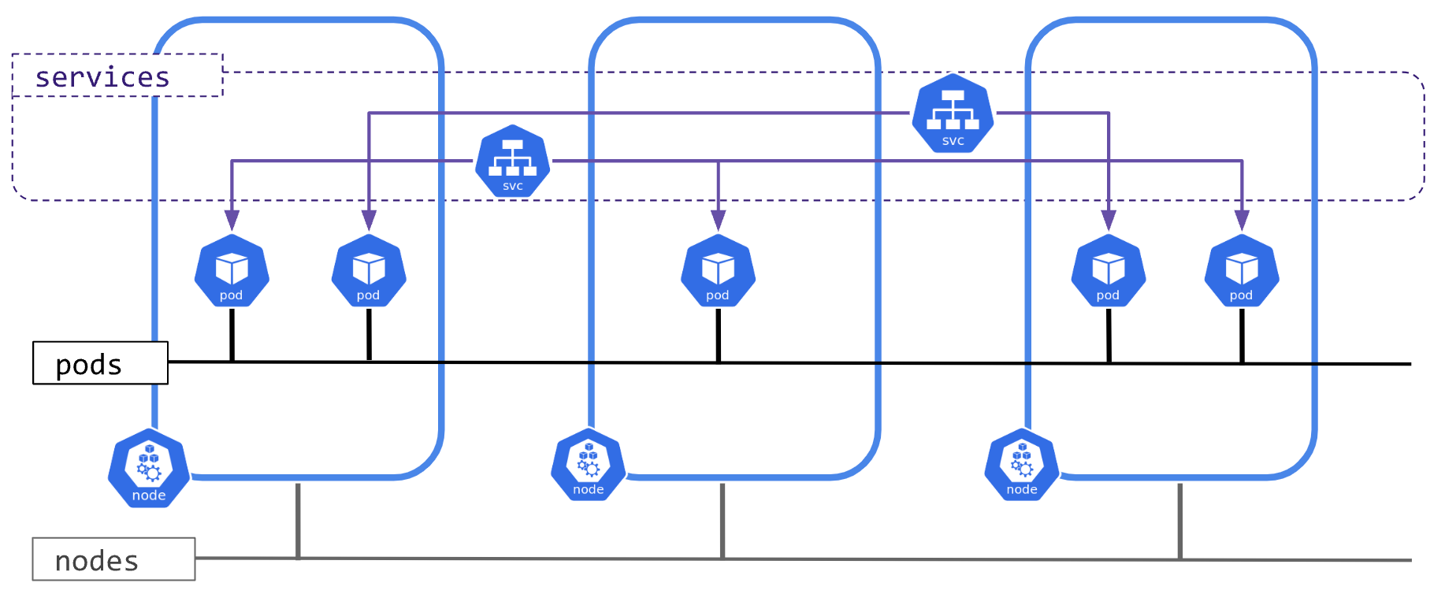
Kubernetes networking (CNI)
Kubernetes must support networking between nodes, pods, and external requests.
CNI is essential for setting up and managing pod networking, providing flexibility through pluggable network providers that adhere to the CNI standard.

Slide 22
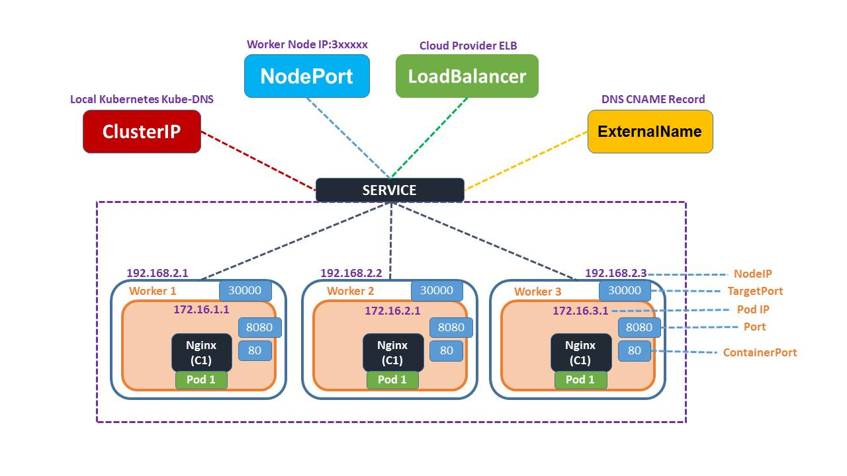
Kubernetes networking example
https://k21academy.com/docker-kubernetes/kubernetes-for-beginners/

Slide 23
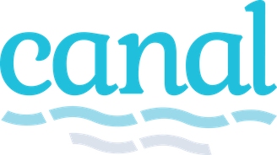


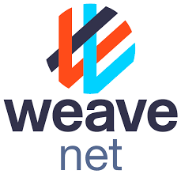
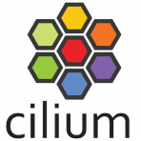
CNI Communities – GitHub metrics
Provider | Project | Stars | Forks | Contributors
Canal | https://github.com/projectcalico/canal | 716 | 100 | 20
Flannel | https://github.com/flannel-io/flannel | 8.8k | 2.9k | 234
Calico | https://github.com/projectcalico/calico | 6.0k | 1.3k | 353
Weave | https://github.com/weaveworks/weave/ | 6.6k | 670 | 85
Cilium | https://github.com/cilium/cilium | 20.0k | 2.9k | 832

Slide 24

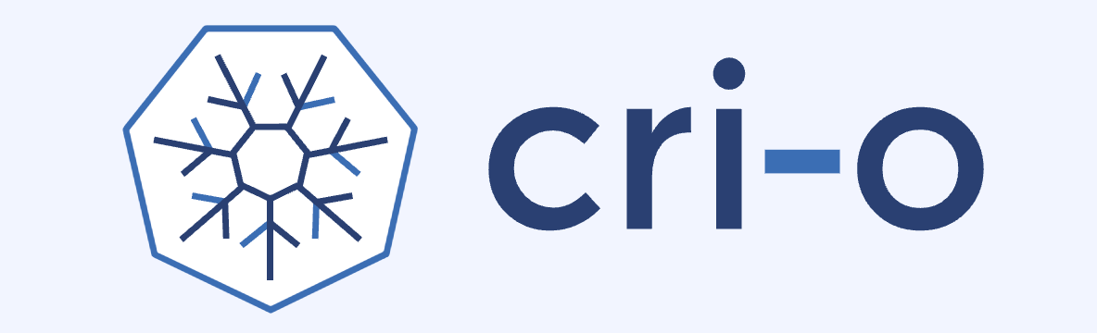

Kubernetes runtimes (CRI)
Container Runtime Interfaces
Containerd: A full-featured container runtime that uses runc as its default OCI runtime.
CRI-O: A lightweight OCI-compliant container runtime that can use runc or other OCI-compliant runtimes. It's designed to be a simple and efficient container runtime.
Platform-Specific Runtime:
runhcs: A Windows-specific container runtime that uses the Hyper-V virtualization platform. It's used for running Windows containers on Windows hosts using Host Compute Service (HCS).
HCS
CRI decouples Kubernetes from specific Container Runtimes.

Slide 25
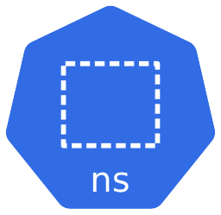
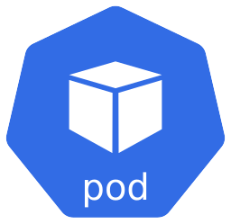
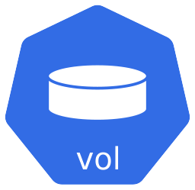
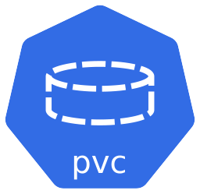
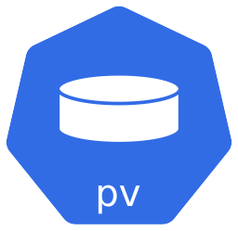
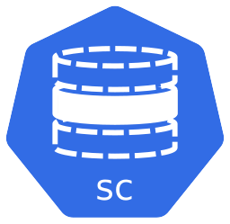
Kubernetes storage (CSI)
Kubernetes supports multiple storage capabilities.
Storage attached to the Node (server)
Storage attached to the Node (server)
CSI
Cluster level defined objects (resources).
CSI provides a standardized interface for storage, so Kubernetes can support any CSI-compliant storage provider.

Slide 26
CSI options (partial list)
At this web site https://storageclass.info/csidrivers/ has a 150 vendors listed with CSI offerings.
Below are some of the leading vendors:
Amazon Web Services (AWS): Offers CSI drivers for services like Elastic Block Store (EBS) and Elastic File System (EFS), allowing Kubernetes workloads to utilize AWS storage solutions.
Microsoft Azure: Provides CSI drivers for Azure Disk and Azure File, enabling Kubernetes applications to leverage Azure's storage offerings.
Google Cloud Platform (GCP): Supplies CSI drivers for Google Compute Engine Persistent Disk and Filestore, facilitating integration with GCP's storage services.
NetApp: Delivers the Trident CSI driver, supporting various NetApp storage systems, including ONTAP and SolidFire, for Kubernetes environments.
Dell EMC: Offers CSI drivers for storage platforms such as PowerMax, PowerScale, and PowerStore, enabling Kubernetes integration with Dell EMC storage solutions.
Hewlett Packard Enterprise (HPE): Supplies a CSI driver supporting HPE storage platforms like Nimble Storage and 3PAR, facilitating Kubernetes integration.
Portworx: Offers a CSI driver that provides cloud-native storage solutions tailored for Kubernetes environments, supporting features like snapshots, backups, and disaster recovery.

Slide 27
Communication with Kubernetes
How to communicate with the cluster

Slide 28

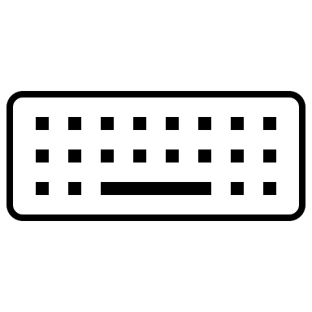
Kubernetes communication & control
The core of Kubernetes control plane is the API server
The API server lets you query and manipulate the state of objects in Kubernetes.
Cluster
Control Plane
(locally installed)
kubectl
CLI tool to communicate with k8s
End users, different parts of the cluster, and external components all communicate with one another through the API server.
Container Runtime
Container Runtime
Container Runtime
Worker Node
Worker Node
Worker Node
Master Node

Slide 29
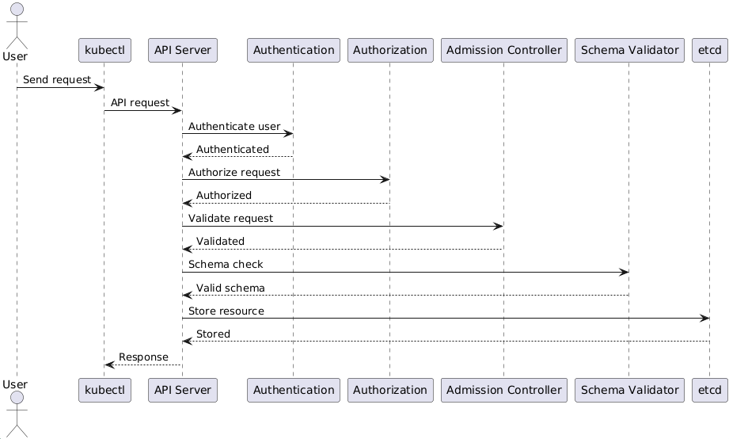
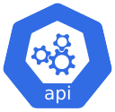
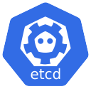
Kubernetes kubectl request interactions
kubectl
Control Plane
UML interaction diagram created with PlantUML at https://plantuml.com/

Slide 30
Objects / Resources
The building blocks of Kubernetes

Slide 31
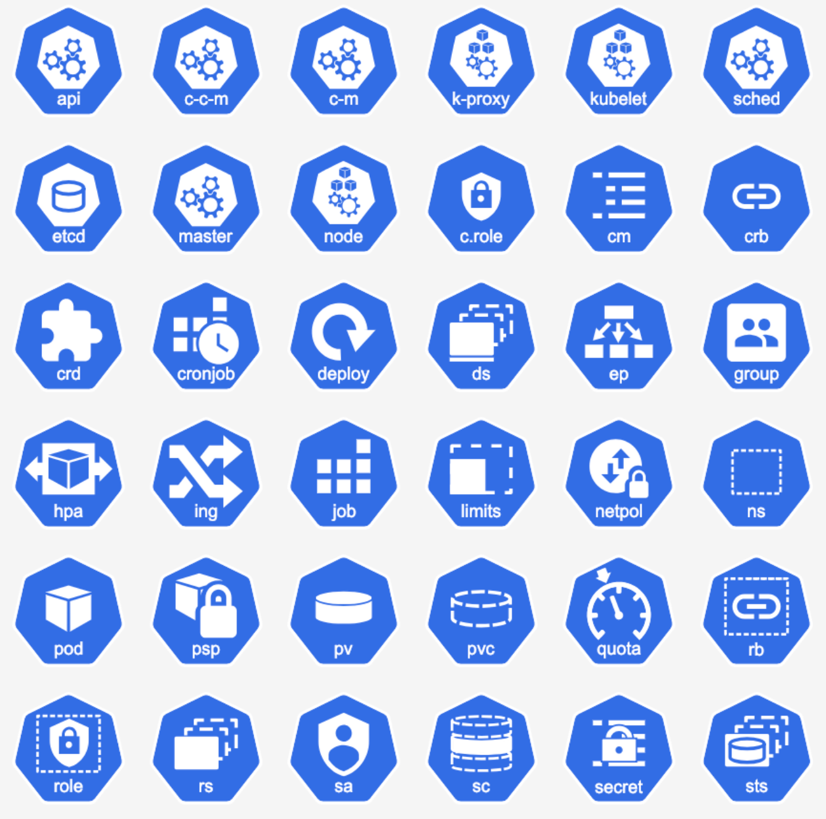
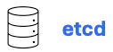
Kubernetes objects / resources
Kubernetes objects are persistent entities in the Kubernetes system. Kubernetes uses these entities to represent the state of your cluster.
All object definitions are stored in ‘etcd’ a key component in the control plane.
Icons that represent some of the object types that are defined in Kubernetes.

Slide 32
Kubernetes objects / resources
Kubernetes provided objects by category
Workload
Authorization
Service
Policy
Config & Storage
Extend
Authentication
Cluster
Custom or 3rd party objects
Custom
3rd party

Slide 33
Kubernetes objects / resources
Workload resources (partial list)
Workload
Type | Description
Pod | Pod is a collection of containers that can run on a host.
Deployment | Deployment enables declarative updates for Pods and ReplicaSets.
DaemonSet | DaemonSet represents the configuration of a daemon set.
StatefulSet | StatefulSet represents a set of pods with consistent identities.
Job | Job represents the configuration of a single job.
Cronjob | CronJob represents the configuration of a single cron job.
HorizontalPodAutoscaler | HorizontalPodAutoscaler is the configuration for a horizontal pod autoscaler, which automatically manages the replica count of any resource implementing the scale subresource based on the metrics specified.
ReplicaSet | ReplicaSet ensures that a specified number of pod replicas are running at any given time.

Slide 34
Kubernetes objects / resources
Config & Storage resources (partial list)
Config & Storage
Type | Description
ConfigMap | ConfigMap holds configuration data for pods to consume.
Secret | Secret holds secret data of a certain type.
PersistentVolume | PersistentVolume (PV) is a storage resource provisioned by an administrator.
PersistentVolumeClaim | PersistentVolumeClaim is a user's request for and claim to a persistent volume.
StorageClass | StorageClass describes the parameters for a class of storage for which PersistentVolumes can be dynamically provisioned.
Volume | Volume represents a named volume in a pod that may be accessed by any container in the pod.
CSIDriver | CSIDriver captures information about a Container Storage Interface (CSI) volume driver deployed on the cluster.
CSINode | CSINode holds information about all CSI drivers installed on a node.

Slide 35
Kubernetes objects / resources
Service
Service resources (partial list)
Type | Description
Service | Service is a named abstraction of software service (for example, mysql) consisting of local port (for example 3306) that the proxy listens on, and the selector that determines which pods will answer requests sent through the proxy.
EndpointSlice | EndpointSlice represents a subset of the endpoints that implement a service.
Ingress | Ingress is a collection of rules that allow inbound connections to reach the endpoints defined by a backend.
IngressClass | IngressClass represents the class of the Ingress, referenced by the Ingress Spec.
Cluster resources (partial list)
Cluster
Type | Description
Node | Node is a worker node in Kubernetes.
Namespace | Namespace provides a scope for Names
Event | Event is a report of an event somewhere in the cluster.

Slide 36
Kubernetes objects / resources
Authorization resources (partial list)
Authorization
Type | Description
Role | Role is a namespaced, logical grouping of PolicyRules that can be referenced as a unit by a RoleBinding.
ClusterRole | ClusterRole is a cluster level, logical grouping of PolicyRules that can be referenced as a unit by a RoleBinding or ClusterRoleBinding.
RoleBinding | RoleBinding references a role, but does not contain it.
ClusterRoleBinding | ClusterRoleBinding references a ClusterRole, but not contain it.
Authentication resources (partial list)
Authentication
Type | Description
ServiceAccount | ServiceAccount binds together: * a name, understood by users, and perhaps by peripheral systems, for an identity * a principal that can be authenticated and authorized * a set of secrets.
TokenRequest | TokenRequest requests a token for a given service account.
TokenReview | TokenReview attempts to authenticate a token to a known user.

Slide 37
Kubernetes objects / resources
Policy resources (partial list)
Policy
Type | Description
LimitRange | LimitRange sets resource usage limits for each kind of resource in a Namespace.
ResoureQuota | ResourceQuota sets aggregate quota restrictions enforced per namespace.
NetworkPolicy | NetworkPolicy describes what network traffic is allowed for a set of Pods.
Extend resources (partial list)
Extend
Type | Description
CustomResourceDefinition | CustomResourceDefinition represents a resource that should be exposed on the API server.

Slide 38
etcd
Persistence store for all Kubernetes objects
(pronounced et-see-dee)

Slide 39

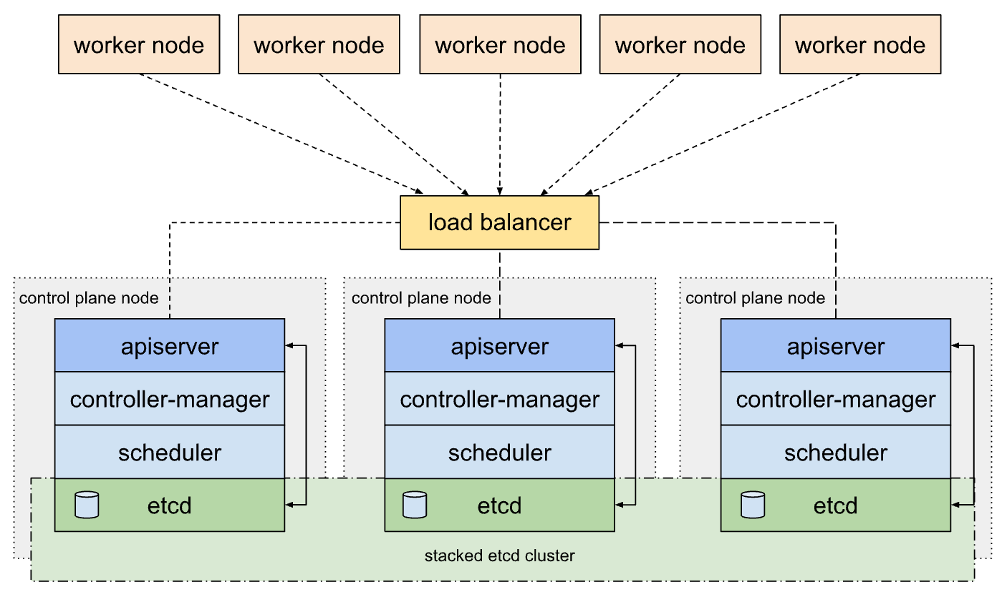
etcd (persistence layer)
The etcd stores all cluster information, such as its current state, desired state, configuration of resources, and runtime data.
An HA (high availability) cluster will have multiple etcd instances.
Source: https://kubernetes.io/docs/setup/production-environment/tools/kubeadm/ha-topology/

Slide 40
Object / resource creation
Objects must be defined and created

Slide 41
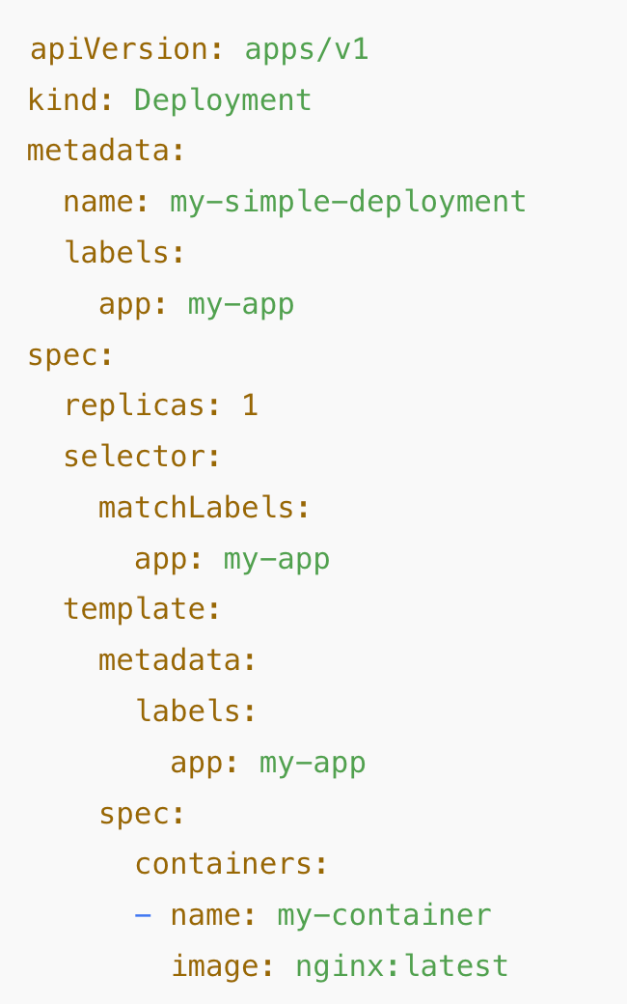
Kubernetes object / resource creation
When you create an object in Kubernetes, you must provide the object spec that describes its desired state, this is the manifest.
Example manifest
‘spec’ section of the manifest
The manifest is saved as a file and used with the kubectl CLI.
The manifest can be defined using either YAML or JSON formatting.

Slide 42
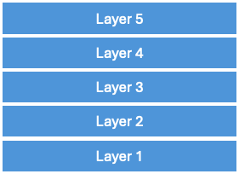
Kubernetes manifest
Every resource in Kubernetes has a manifest associated.
Deployment manifest
Container Registry
Deployment
ReplicaSet
Pod
Container
Pull
Use this container from the container registry.

Slide 43
Kubernetes object / resource creation
The Kubernetes CLI tool (kubectl) is used to send the manifest information to the API server to create the object.
Using kubectl send the ‘manifest’ to the API server.
Control Plane
kubectl
kubectl command:
kubectl apply -f /Users/bob/k8s/nginx-deploy. yml
Master Node
Control Plane

Slide 44
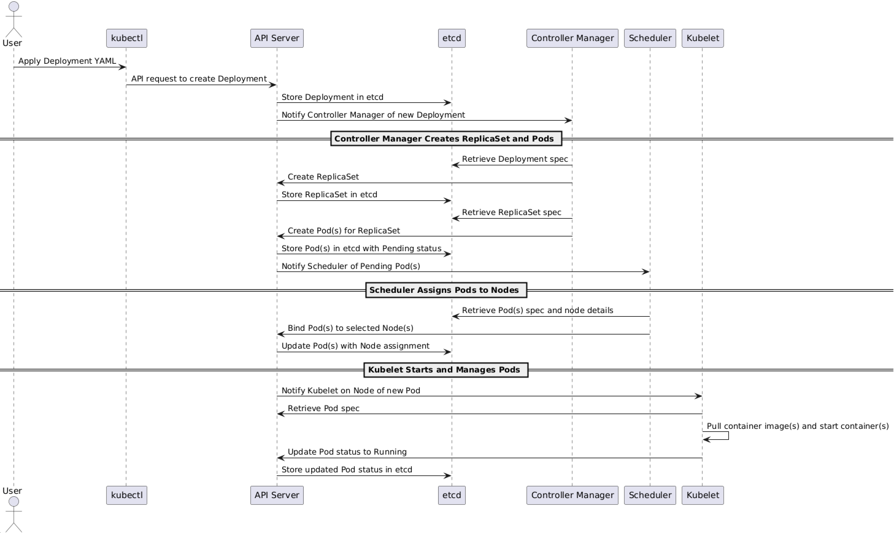
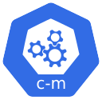

Kubernetes object creation interactions
kubectl
Control Plane
Worker Node
UML interaction diagram created with PlantUML at https://plantuml.com/

Slide 45
Pods & Containers

Slide 46
Pods
Pods are the smallest deployable units of computing that you can create and manage in Kubernetes.
A Pod is a group of one or more containers, with shared storage and network resources, and a specification for how to run the containers.
A Pod can contain init containers that run during Pod startup. You can also inject ephemeral containers for debugging a running Pod.

Slide 47
Containers
init container
init container
A specialized container that runs before the main application containers in a Pod.
Its purpose is to perform setup tasks that need to be completed before the main application containers start.
Init containers run sequentially, meaning each one must complete successfully before the next init container runs.
Only after all init containers complete successfully will the main application containers start.

Slide 48
Containers
ephemeral container
ephemeral container
Are temporary containers that you can add to a running Pod for troubleshooting and debugging purposes without modifying the Pod's specification.
They provide a way to inspect and interact with the application in the Pod, helping you diagnose issues on live containers that might be hard to reproduce elsewhere.

Slide 49
Containers
container
container
In Kubernetes, a normal container refers to the main application containers defined in a Pod's specification.
These containers run the primary application workloads and are the core units of work within a Pod.
Unlike init containers and ephemeral containers, which serve specific setup and debugging purposes, normal containers are responsible for the primary functionality of the Pod.

Slide 50
Pods identify the container(s) to run
Containers are defined inside a Pod.
Deployment with replicas, networking, storage, CPU & Memory limits, probes, and variables
Pod with a single container
Deployment with multiple containers
Pod
Deployment
Deployment
Container
Pod
ReplicaSet
Container
Pod
Container
Container
Environment Variables
NOTE: Pods are generally not created directly and are created using workload resources.
Volume Mounts
Ports
Liveness Probe
Readiness Probe
Resources

Slide 51
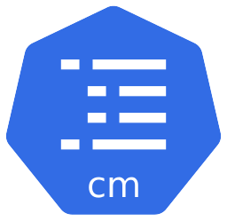
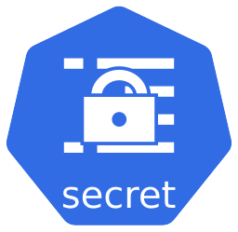
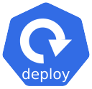
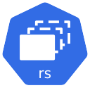








Kubernetes Pods
The Pod is the core for getting work done in Kubernetes. Pods use other defined resources or interfacing with other resources in the cluster.
Cluster
Namespace
Configuration
Workload
Pod
Service
Container
Events
Storage
Security
Events

Slide 52
Examples of deployed Pods

Slide 53

Kubernetes - schematic
“Pod” with no additional resources.

Slide 54

Kubernetes - schematic
“Deployment” with a replica set and three secrets.

Slide 55

Kubernetes - schematic
“Deployment” with replica set, a single config map, three secrets, persistent volume claim, and network ports.

Slide 56

Kubernetes - schematic
CRC (Custom Resource Definition) created Pod with multiple containers and network port.
Custom Resource Definition

Slide 57
Kubernetes OwnerReferences

Slide 58


Kubernetes - owner references
Owner reference chains affect objects durability
Each Kubernetes resource can have an ownerReferences field in its metadata, which lists the owning resources.
The ownerReferences field is an array, meaning a resource can technically have multiple owners (though it’s typically one).
Owner Reference chain
ZenService
manifest

Slide 59
Kubernetes Controllers & Control Loop
How things are managed in Kubernetes

Slide 60

Kubernetes control loop pattern
Controllers are the control loops that observe the state of a K8s cluster.
Control Plane
Observe – What is the desired state of our objects?
Compare – What is the current state of our objects and the differences between our desired state?
Action – Make the current state look like the desired state.
Repeat – Repeat Observe, Compare, Action.
Master Node

Slide 61
Kubernetes controller design
Each of the Controllers will monitor their specific Kubernetes object type for changes by connecting to the API Server.
The API Server is a mandatory entry point for any API data stored in the cluster's control plane database, called etcd.
All Controllers monitor resources by contacting the API Server, which will query data from etcd and return the object's current configuration.

Slide 62

Kubernetes ‘spec’ and ‘status’
Control Loop
kubectl get deploy nginx-deploy -o yaml
Observe
Get state of our objects:
spec
spec = desired state
status = current state
Compare
Does the current state of our objects match the desired state?
Action
Make the current state look like the desired state.
status

Slide 63

Kubernetes controller
The desired state of an object is present in the spec field. So, the controller is responsible for bringing the cluster from the observed state to the desired state.
Source: https://k21academy.com/docker-kubernetes/kubernetes-operator

Slide 64

Kubernetes control loop interactions
kubectl
Control Plane
Worker Node
UML interaction diagram created with PlantUML at https://plantuml.com/

Slide 65
Some of the k8s built-in controllers
Controller | Description
Node | Responsible for managing Worker Nodes. It will monitor the new Nodes connecting to the cluster, validate the Node's health status based on metrics reported by the Node's Kubelet component, and update the Node's .status field. If a Kubelet stops posting health checks to the API Server, the Node Controller will be responsible for triggering Pod eviction from the missing Node before removing the Node from the cluster.
Deployment | Responsible for managing Deployment objects and creating/modifying ReplicaSet objects.
ReplicaSet | Responsible for creating/modifying Pods based on the ReplicaSet object configuration.
Service | Responsible for configuring ClusterIP, NodePort, and LoadBalancer configuration based on Service objects.
CronJob | Responsible for creating Job objects based on the Cron schedule defined in CronJob objects.
StatefulSet | Responsible for creating Pods in a guaranteed order with a sticky identity.

Slide 66
Kubernetes controller type summary
Controller Type | Functionality
Core Controllers | Node, Replication, ReplicaSet, Deployment, DaemonSet, Job, CronJob, StatefulSet, Service, Namespace, Endpoint, ResourceQuota, LimitRange
Autoscaling Controllers | Horizontal Pod Autoscaler, Vertical Pod Autoscaler
Network and Access Controllers | Network Policy, Ingress
Resiliency Controllers | Pod Disruption Budget
Custom Controllers are discussed in the section “Operators Custom Controllers”.

Slide 67
Kubernetes control loop pattern
Controllers are the control loops that observe the state of a K8s cluster.
Controllers
Control Plane
Controllers
Every defined controller will be processed in the control manager control loop.
Master Node

Slide 68
Kubernetes Scheduler
Where to run resources Kubernetes

Slide 69

Scheduler
The scheduler is a vital part of Kubernetes, responsible for figuring out the best places to run your containers within a cluster.
It makes these decisions based on factors such as available resources, defined rules, and desired preferences.
In a nutshell, it determines which computers (nodes) in the cluster are the most suitable to host each component of your application (containers).
Source: https://www.atatus.com/blog/kubernetes-scheduler/

Slide 70

Kubernetes default scheduling
While the scheduler determines where each pod should run, it is not responsible for running the pod—that's the kubelet's job.
Source: https://www.atatus.com/blog/kubernetes-scheduler/

Slide 71


Node Selectors
Controlling Pod Placement
One of the simplest yet effective ways to influence where your pods are scheduled within a Kubernetes cluster is by using a node selector. Node selectors are a straightforward method to control the placement of your pods within a Kubernetes cluster.
Source: https://www.atatus.com/blog/kubernetes-scheduler/

Slide 72

Scheduler interactions
kubectl
Control Plane
Worker Node
UML interaction diagram created with PlantUML at https://plantuml.com/

Slide 73
Kubernetes kubelet
The brains of the Worker Node

Slide 74
Kubernetes Kubelet
Kubelet is an essential component that runs on each node (worker machine) in the cluster. It acts as the node agent and is responsible for ensuring that containers are running and healthy on the node.
Kubelet works closely with the Kubernetes control plane to manage and maintain the desired state of containers as defined in the cluster's configurations.

Slide 75






Kubernetes Worker Node
Worker nodes can have 100’s of objects.
Namespace
Namespaces allow you to separate resources (e.g., pods, services, deployments) into isolated groups.
Container Runtime
DaemonSet
DaemonSet in is a type of workload that ensures a specific pod runs on every (or selected) node in the cluster.
DaemonSets are typically used for deploying system-level services or monitoring agents that need to be present on each node, providing essential services such as logging, monitoring, or network proxies.
Worker Node

Slide 76

Kubelet interactions to run the pod
kubectl
Control Plane
Worker Node
Container Runtime
UML interaction diagram created with PlantUML at https://plantuml.com/

Slide 77
Kubernetes kube-proxy
Networking at the node

Slide 78
Kube-proxy
Kube-Proxy is a Kubernetes agent that is optionally installed on every node in the cluster.
It monitors the changes that happen to Service objects and their endpoints. If changes occur, it translates them into actual network rules inside the node.
Kube-Proxy usually runs in your cluster in the form of a DaemonSet. But it can also be installed directly as a Linux process on the node.

Slide 79

kube-proxy interactions at service create
kubectl
Control Plane
Worker Node
UML interaction diagram created with PlantUML at https://plantuml.com/

Slide 80

Kube-proxy interactions
Network request
Control Plane
Worker Node
UML interaction diagram created with PlantUML at https://plantuml.com/

Slide 81
Complex manifests and reuse with Helm Charts

Slide 82
Complex manifests
Complex “Deployments” can require multiple manifest files be created. When there is a need to reuse the definitions Helm Charts provide a parameter driven solution.
1 manifest
6 manifests
1 manifest
1 manifest
1 manifest
1 manifest
1 manifest

Slide 83

DevOps simplified with Helm Charts
Helm charts are a very powerful tool that can help standardize your Kubernetes deployments and avoid reinventing the wheel over and over.
Helm charts improve the productivity of DevOps and application teams by abstracting the complexities of Kubernetes YAML files and enable organizations to easily adopt.
Helm charts are a combination of Kubernetes YAML manifest templates and helm-specific files.

Slide 84


Helm Chart structure
To understand the Helm chart, let’s take an example of Nginx deployment. To deploy Nginx on Kubernetes, typically you would have the following YAML files.
Now if we create a Helm Chart for the above Nginx deployment, it will have the following directory structure.
Source: https://devopscube.com/create-helm-chart/

Slide 85
Helm Templates
The idea of a helm chart is to template the YAML files so that we can reuse them in multiple environments by dynamically assigning values to them.
To template a value, all you need to do is add the object parameter inside curly braces as shown below. It is called a template directive, and the syntax is specific to the Go templating
Source: https://devopscube.com/create-helm-chart/

Slide 86

Helm template with defined parameters
Source: https://devopscube.com/create-helm-chart/

Slide 87

Helm chart use
Deploying to multiple environments using a defined Helm chart and ‘values’ files.
Each environment provide the needed values to deploy in the resources defined in the Helm chart.
The same Helm chart will be used for all environments.
Source: https://devopscube.com/create-helm-chart/

Slide 88

Some stats on Helm Chart usage
Over 830 thousand

Slide 89
Operators & Custom Controllers
Custom Resource Definitions

Slide 90
Operators define custom controllers
The Operator is defined via the Kubernetes object called Custom Resource Definitions (CRDs).
Operators are custom controllers that implement the Operator Pattern, an approach to adding new automation into Kubernetes.
The operator is nothing but software that does everything a human operator does.
Source: https://www.uffizzi.com/kubernetes-multi-tenancy/kubernetes-controllers

Slide 91
Operators
Kubernetes Operators are used to automate complex application management tasks that go beyond what Helm charts or basic Kubernetes manifests can handle.
Operators can continuously monitor and manage the application's state, automatically responding to changes or issues without manual intervention.
For example, they can handle tasks like scaling, backups, failover, and configuration updates.

Slide 92
When to use a Kubernetes Operator
Some reasons why the Kubernetes operators are needed:
The Operators extend Kubernetes functionality.
Our ideas and knowledge can be defined in an operator.
K8s Operators do this in a scalable, repeatable, standardized fashion.
Operators improve resiliency while reducing the burden on IT teams.
Operators prove particularly useful in multi-cloud and hybrid cloud environments.

Slide 93
Operators are custom controllers
Operator
Custom
controller
Control Plane
Every defined operator custom controller will be processed in the control manager control loop.
Master Node

Slide 94
Kubernetes Security RBAC
Role Based Access Control

Slide 95




Kubernetes RBAC Security
Role-based access control (RBAC) is a technique of regulating access to a computer or network resources based on the roles of individual users within an enterprise. In this context, access is the ability of a private user to perform a selected task, like read, create, or modify a file.
Role
Binding
Subject
Namespace level
Cluster level
Source: https://k21academy.com/docker-kubernetes/rbac-role-based-access-control/

Slide 96


Authentication and Authorization
In Kubernetes, you must be authenticated (logged in) before your request can be authorized (granted permission to access).
Source: https://k21academy.com/docker-kubernetes/rbac-role-based-access-control/

Slide 97

Role Binding in RBAC
Role Binding in Kubernetes Role Based Access Control is used for granting permission to a Subject in a Kubernetes cluster. Subjects are nothing but a group of users, services, or team making an attempt at Kubernetes API. It defines what operations a user, service, or a group can perform.
Source: https://k21academy.com/docker-kubernetes/rbac-role-based-access-control/

Slide 98

Cluster Role Binding in RBAC
Cluster Role Binding in RBAC is used to grant permission to a subject on a cluster-level in all the namespaces. It will offer you permissions for cluster resources and it can even offer you with permissions for resources within any namespace within a cluster. Cluster role bindings are very powerful, and you want to be careful with how you apply them because they apply not solely to any existing namespaces but to any future namespaces that you just might create yet.
Source: https://k21academy.com/docker-kubernetes/rbac-role-based-access-control/

Slide 99

RBAC interactions for deploying a Pod

Slide 100

RBAC interactions for accessing configMap

Slide 101

RBAC interactions for audit logs

Slide 102

Overview of Kubernetes security features
Kubernetes security is multi-layered, covering access control, network policies, pod configurations, runtime protections, and more. Together, these security features help protect Kubernetes clusters and workloads against a range of threats, ensuring a more resilient and secure environment.

Slide 103
Deployment example

Slide 104

Kubernetes Deployment
A Deployment owns and manages one or more ReplicaSets. And Replica Set manages the basic units in Kubernetes – Pods.
A deployment manifest file includes the pod definition, the number of replicas and can include the preferred deployment strategy.
Source: https://k21academy.com/docker-kubernetes/kubernetes-deployment/

Slide 105

Kubernetes Deployment
Deployment manifest that will be used

Slide 106

Kubernetes Deployment
kubectl create -f /Users/bob/k8s/nginx-deploy.yml
kubectl get deploy -l app=nginx-app
kubectl get rs -l app=nginx-app
kubectl get po -l app=nginx-app

Slide 107

Kubernetes Deployment
kubectl describe deploy nginx-deploy

Slide 108
Update Kubernetes Deployment
kubectl set image deploy nginx-deploy nginx-container=nginx:1.27.2
kubectl rollout status deployment/nginx-deploy
kubectl get deploy

Slide 109

Rollback Kubernetes Deployment
kubectl set image deploy nginx-deploy nginx-container=nginx:1.27.2 --record
kubectl rollout status deployment/nginx-deploy
kubectl rollout history deployment/nginx-deploy
kubectl rollout undo deployment/nginx-deploy
kubectl rollout status deployment/nginx-deploy

Slide 110

Scale-Up Kubernetes Deployment
kubectl scale deployment nginx-deploy --replicas=5
kubectl get deploy
kubectl get pod

Slide 111

Scale-Up Kubernetes Deployment
Kubectl describe deploy nginx-deploy

Slide 112
Scale-Down Kubernetes Deployment
kubectl scale deployment nginx-deploy --replicas=1
kubectl get deploy
kubectl get po -l app=nginx-app

Slide 113
Delete Kubernetes Deployment
kubectl get po -l app=nginx-app
kubectl delete -f nginx-deploy.yml
kubectl get po -l app=nginx-app

Slide 114
Kubernetes on Windows

Slide 115

Kubernetes on Windows
https://learn.microsoft.com/en-us/virtualization/windowscontainers/deploy-containers/containerd

Slide 116

Kubernetes on Windows
https://learn.microsoft.com/en-us/virtualization/windowscontainers/deploy-containers/containerd

Slide 117
Kubernetes CI/CD

Slide 118

Example CI/CD flow

Slide 119

Kubernetes CI/CD

Slide 120

Possible CI/CD implementation
When triggered by a source code modification event, the GitHub Action Workflow 1 will spring into action and build, compile, and test your application and then package it in a Docker container and publish it to a container repository.
The Workflow 1 passes the Docker image name and tag as input and triggers the Workflow 2, which will update the K8s deployment manifest and commit and push the changes to the Application/K8s Configuration repository.
Argo CD will be pulling this change and update the application on the K8s cluster.
Source: https://igboie.medium.com/kubernetes-ci-cd-with-github-github-actions-and-argo-cd-36b88b6bda64

Slide 121
Getting started with Kubernetes locally
Tools to run Kubernetes locally

Slide 122


K3S
K3s is a highly available, certified Kubernetes distribution designed for production workloads in unattended, resource-constrained, remote locations or inside IoT appliances.

Slide 123

K3D
k3d is a lightweight wrapper to run k3s (minimal Kubernetes distribution) in docker.

Slide 124

KIND
kind is a tool for running local Kubernetes clusters using Docker container “nodes”. kind was primarily designed for testing Kubernetes itself but may be used for local development or CI.

Slide 125

MicroK8s
The effortless Kubernetes Zero-ops, pure-upstream, HA Kubernetes, from developer workstations to production.

Slide 126

Minikube
minikube is local Kubernetes, focusing on making it easy to learn and develop for Kubernetes. All you need is Docker (or similarly compatible) container or a Virtual Machine environment, and Kubernetes is a single command:
minikube start

Slide 127

Several options exist for running k8s locally
Summary of five of the most often used software solutions to run k8s locally.

Slide 128
Getting insight and understanding Kubernetes
Tools to help learning Kubernetes

Slide 129





VpK – Visually presented Kubernetes
View Kubernetes presented in a visual format

Slide 130


Lens
Designed for Developers and DevOps Engineers, Lens provides an unparalleled experience for managing and troubleshooting workloads through one intuitive context-aware UI.

Slide 131




K9s
K9s is a terminal based UI to interact with your Kubernetes clusters.

Slide 132


CNCF Graduated Projects
CNCF projects are the foundation of cloud native computing.

Slide 133
Other

Slide 134

Design Patterns for Kubernetes
Source: https://medium.com/israeli-tech-radar/kubernetes-control-loops-the-secret-sauce-behind-your-microservice-bliss-fdc1344926cd

Slide 135
The End
Presented by Dave Weilert

